Slide 1


Heros, Helsingfors 120329
Vård för papperslösa m.m.
Anne Sjögren
Sjuksköterska
Rosengrenska / Röda Korset
031 741 6207
Jourtelefon: 0704 066670
anne.sjogren@redcross.se
kliniken@rosengrenska.org
Medlem av Sjuksköterskornas Etiska Råd

Slide 2
Simple mathematics
People were without health care
We know health care
But we realize more reasons …

Slide 3
A stone i the shoe…
The whole idea of a civilized society and what that means…

Slide 4
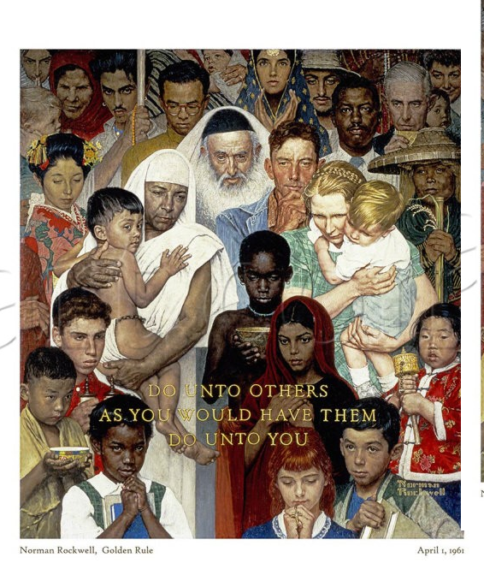

Slide 5
Health care for asylum seekers and UM*
Akut vård
”Vård som inte kan anstå” — asylsökande
Full egen betalning — papperslösa
Barn < 18 år:
Samma sjukvård, tandvård och hälsovård som svenska barn
MEN bara barn som tidigare varit asylsökande
Sedan 2008: Lag (2008:344) om hälso- och sjukvård åt asylsökande m.fl.
Notes:
Henry

Slide 6
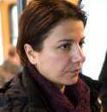
Papperslös? Undocumented Migrant? Irreguljär? Overstayer?
Gömd?
TUT?
EU-medborgare?
Asylsökande?
Flykting?
> eller < 18år?
Avslag?
Papperslös?
Illegal?
Vittne i rättegång?? Offer för trafficking??
Förvirring om status – kopplat till vårdmöjlighet?

Slide 7
To live hidden
- is not to live.

Slide 8
Networks for giving health care for UM
7 places in Sweden
Oslo jan 2009
Helsingfors vintern 2010/11
Köpenhamn augusti 2011

Slide 9
Mostly primary care patients…
But also
Emergancy cases, serious infections
Pregnant women, gynecological problems
Fysically wonded persons, from war, violence…
Traumatised, tortured, raped human beeings
People with contagious problems
Cronical like diabetes, asthma, high blood pressure,
Teeth ace …

Slide 10
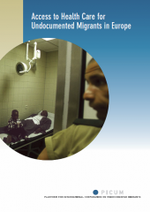
PICUM:
Access to Health Care for Undocumented Migrants
in
11 countries in Europe
(2007)

Slide 11
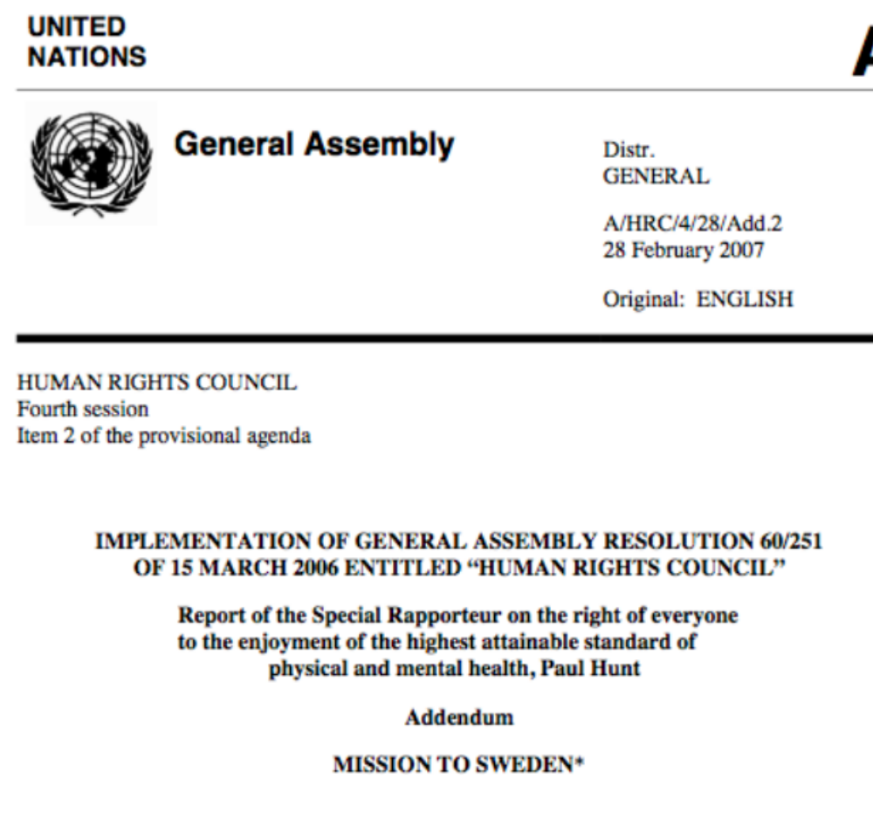
http://ap.ohchr.org/documents/dpage_e.aspx?m=100
Notes:
Anne
January 2006

Slide 12
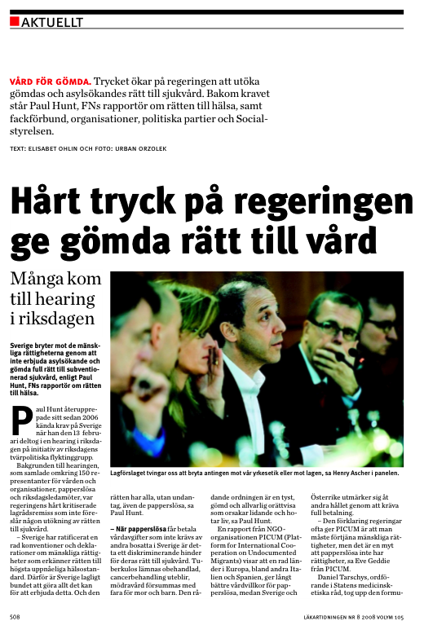
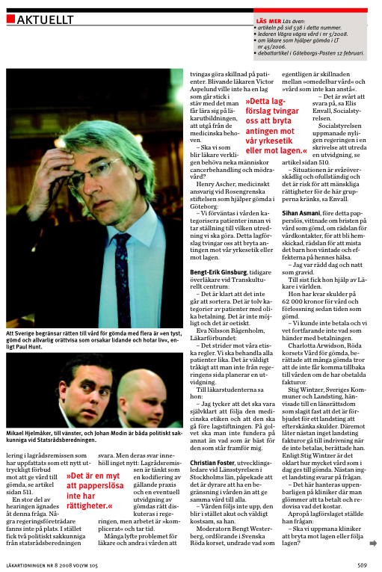
Notes:
Anne

Slide 13
Sweden do not give health care to UM after needs, scientifically nor on equal basis. How is that according to:
- The Humanitarian idéa?
- Ethics of the health care?
- The Human Rights?
- Public Health issues?
Notes:
Anne

Slide 14
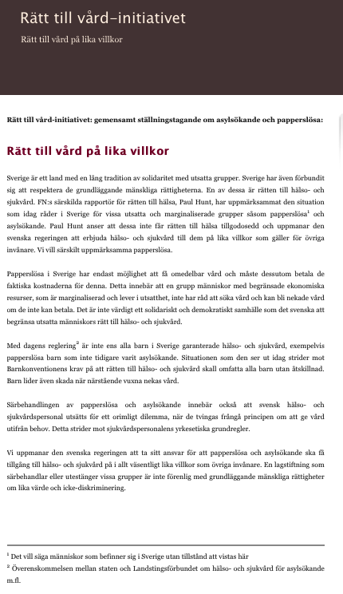
Since 2007:
Right to Health Care-Initiative:
Common standpoint on asylum seekers and other undocumented persons, 2012
62 organisations
www.vardforpapperslosa.se
Notes:
Anne

Slide 15
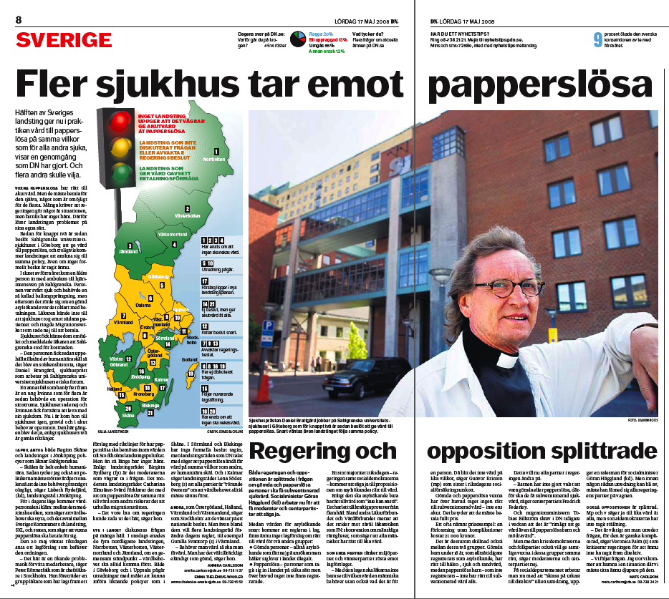
Since
2006
Local PM in Hospitals and Regions in Sweden.
Notes:
Henry

Slide 16
Work to get patients in the regular health care …
Not to treat if there is possibility to get regular health care
Help to self-help
Contacts on all levels
Networking with all good forces
Respect to rules and science
Responsibility to the medical profession

Slide 17

SOU
2011:48
Notes:
17

Slide 18
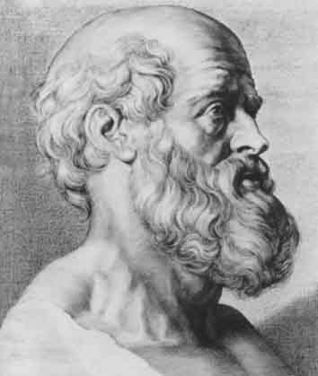
Hippokrates
ca. 460 B.C.
-370 B.C
Notes:
Anne

Slide 19
Rosengrenska since 1998
We began with 5 persons and a cellphone
2004 we had to borrow a place to stay
2008 + the Swedish Red Cross
29 of March 2012 we are 2 366 on the list, have ”a clinic” once a week with 70 patients
A blog, meetings, news once per month
8 sub-groups etc

Slide 20
Since March 2004
A clinic once per week, open every week:
35 volonteers 6 p.m to 10 p.m.
Medical care, doctors, nurses, psycologists, fysioterapists, dentists, receptionists, medicine, interpretators …

Slide 21
The church situation at that time
Segregated area
Poorness
All criteria on …
Tired workers

Slide 22
How to meet challenges
To close out
To make more and more rules
To have more guards, employees, etc
or
To open up
Rely on people as resourses
Open up to good forces
”Participation”

Slide 23
At the same time:
Café +often food for free, 3-5 organisations
Second hand clothes for free, 3 org.
Advises from lawyers, 2 org
Child-care 1 org.
Eye-glasses 1 org.
Trade union 2 org.

Slide 24
Everyone does what he/she is good at

Slide 25
But there are also other values…
True antirascism
Empowerment
”Family”
Normalization
Organisation
Participation
Stabilisation of people with PTSD

Slide 26
We also use it as
A place for doctors and nurses to learn more, useful in the regular health care
For artists, photographers, journalists, researchers etc to meet this group themselves
For contacts in universities, society, churches, organisations outside

Slide 27
A Changing World
We meet people from the places where it´s war and…
1998 people from Iran, Balkan…
2010/11 biggest group from Iraq
Coming more and more from Somalia
We meet mostly hidden persons, rejected asylumseekers

Slide 28
Speciel vulnurable groups:
Children
Women
Traumatizised
HBTQ
Cronically ill persons
Old people

Slide 29
Volunteering
Volunteers from different back-ground get more possibilities, training, contacts,
Good example to others

Slide 30
Conflicts are rare…

